Slide 1






Slide 2

TEAM-91
Activity Point Tracking
Mohammed Faisal Hussain
Mohammed Aquib
Mohammed Affan Zuhaib
Kolluru Chaitanya
GVN Akhil
1
2022 HACKTOBERFEST. ALL RIGHTS RESERVED

Slide 3
PROBLEM STATEMENT:- Activity Points Tracker
Description:-
Develop an application where students can upload there certificates
related to course completion, internship offer to track all activities (academic and
extra-curricular) of a student. Then assign points based on type of certificate and
generate overall feedback of the student.
2
2022 HACKTOBERFEST. ALL RIGHTS RESERVED

Slide 4
IMPLEMENTATION / METHODOLOGY
ADMIN:
Provided with the facility to add students along with the mentor for each class to the System.
MENTOR:
Awards the activity points by verifying all certificates submitted by student.
A Dashboard which shows the no. of students submitted and pending submissions.
Mentor can also provide feedback to the students.
Mentor will also guiding the students in earning the activity point.
3
2022 HACKTOBERFEST. ALL RIGHTS RESERVED

Slide 5
IMPLEMENTATION / METHODOLOGY
STUDENT:
Dashboard is provided showing the points secured in sem-wise
A student in order to acquire the activity point must upload relevant certificate.
Activity points includes academics , co-curricular and extracurricular activities performed by the students.
3
2022 HACKTOBERFEST. ALL RIGHTS RESERVED

Slide 6
TECH STACK
TechStack Used – MERN Stack
MongoDB
ExpressJS
ReactJS
NodeJS
4
2022 HACKTOBERFEST. ALL RIGHTS RESERVED

Slide 7
RESULTS
Screenshots of Application
5
2022 HACKTOBERFEST. ALL RIGHTS RESERVED

Slide 8
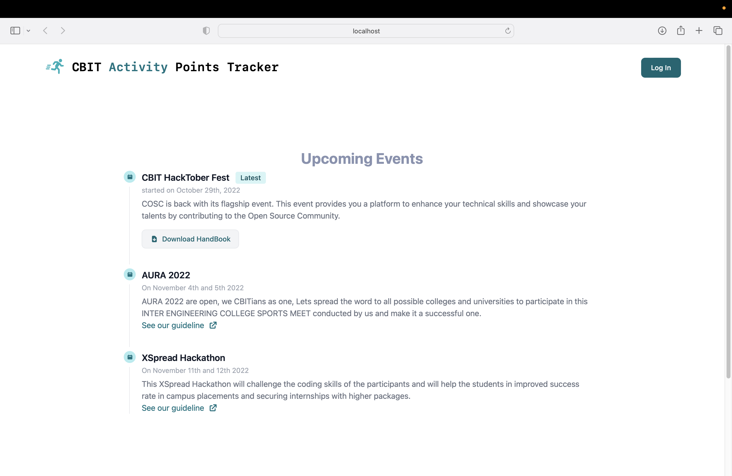

Slide 9
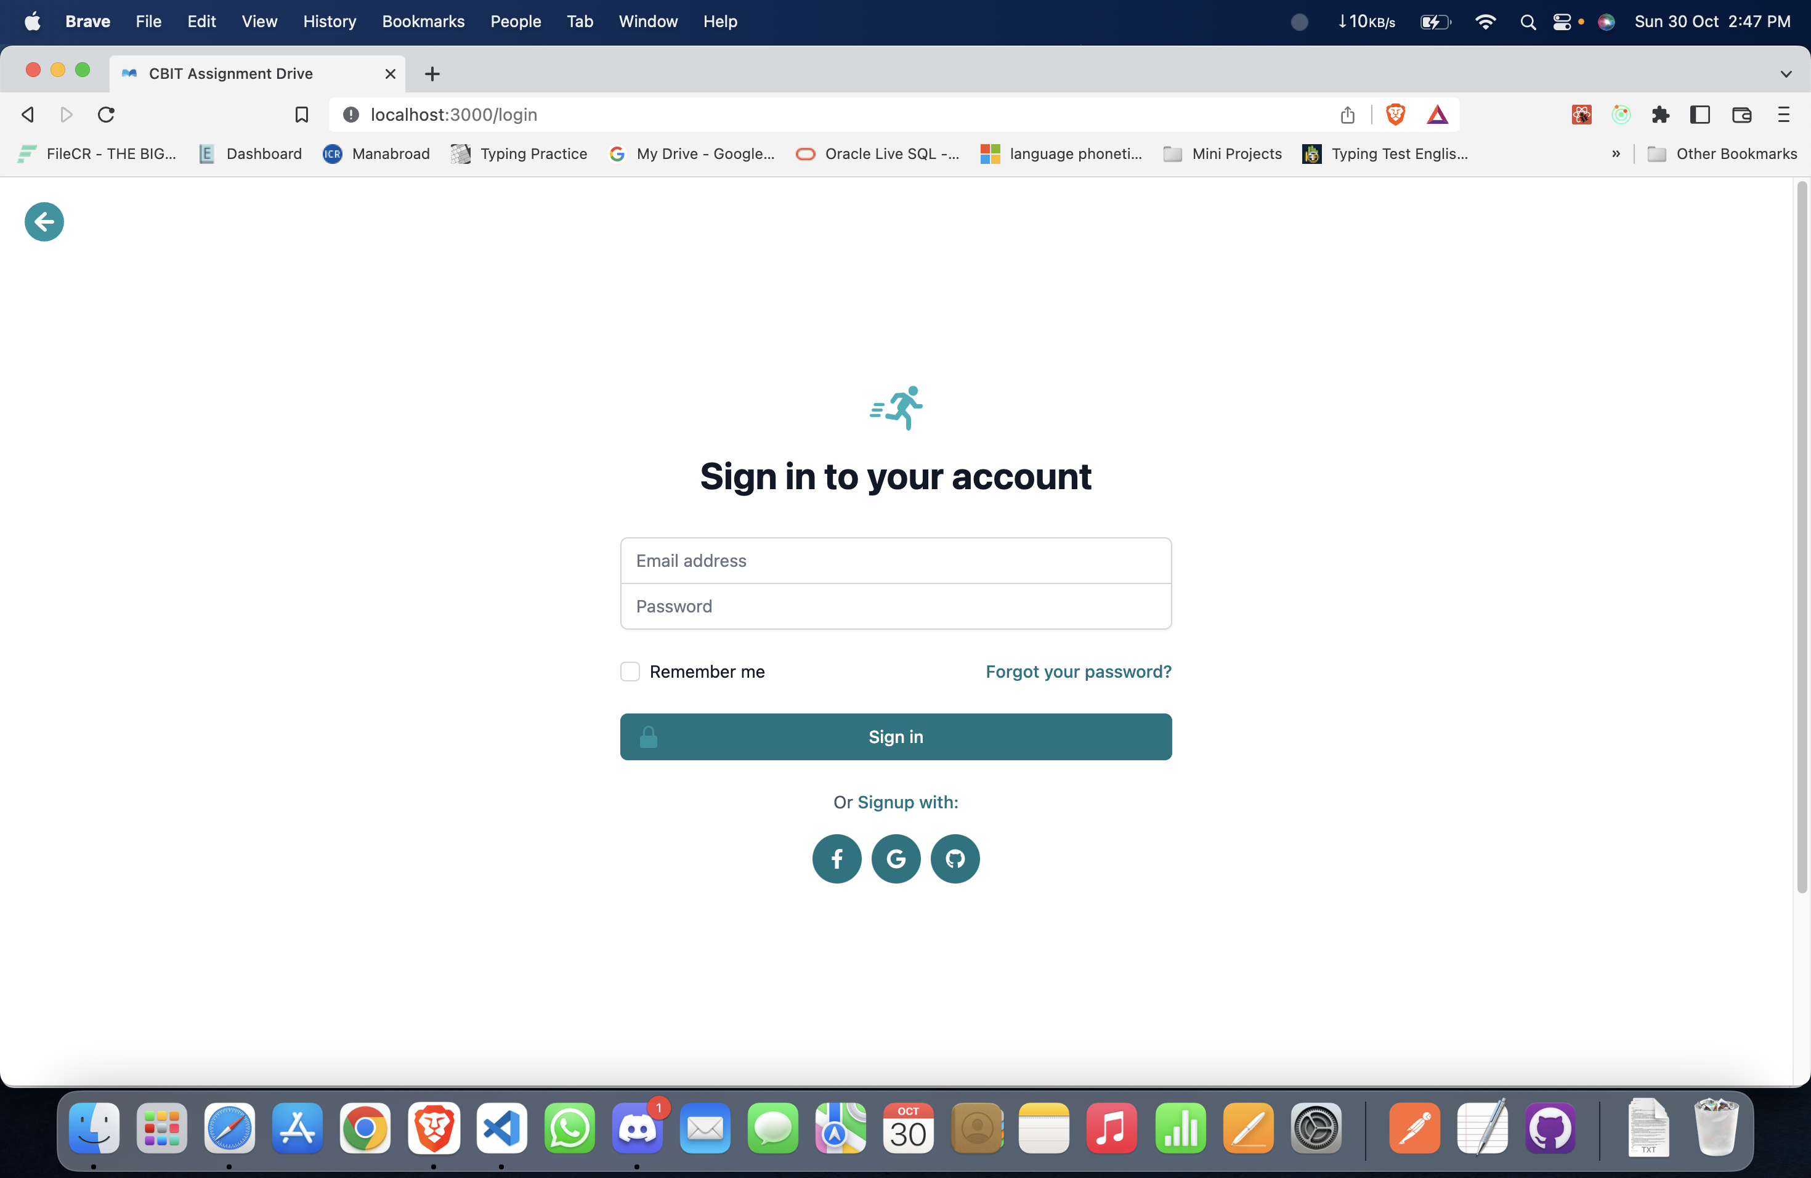

Slide 10
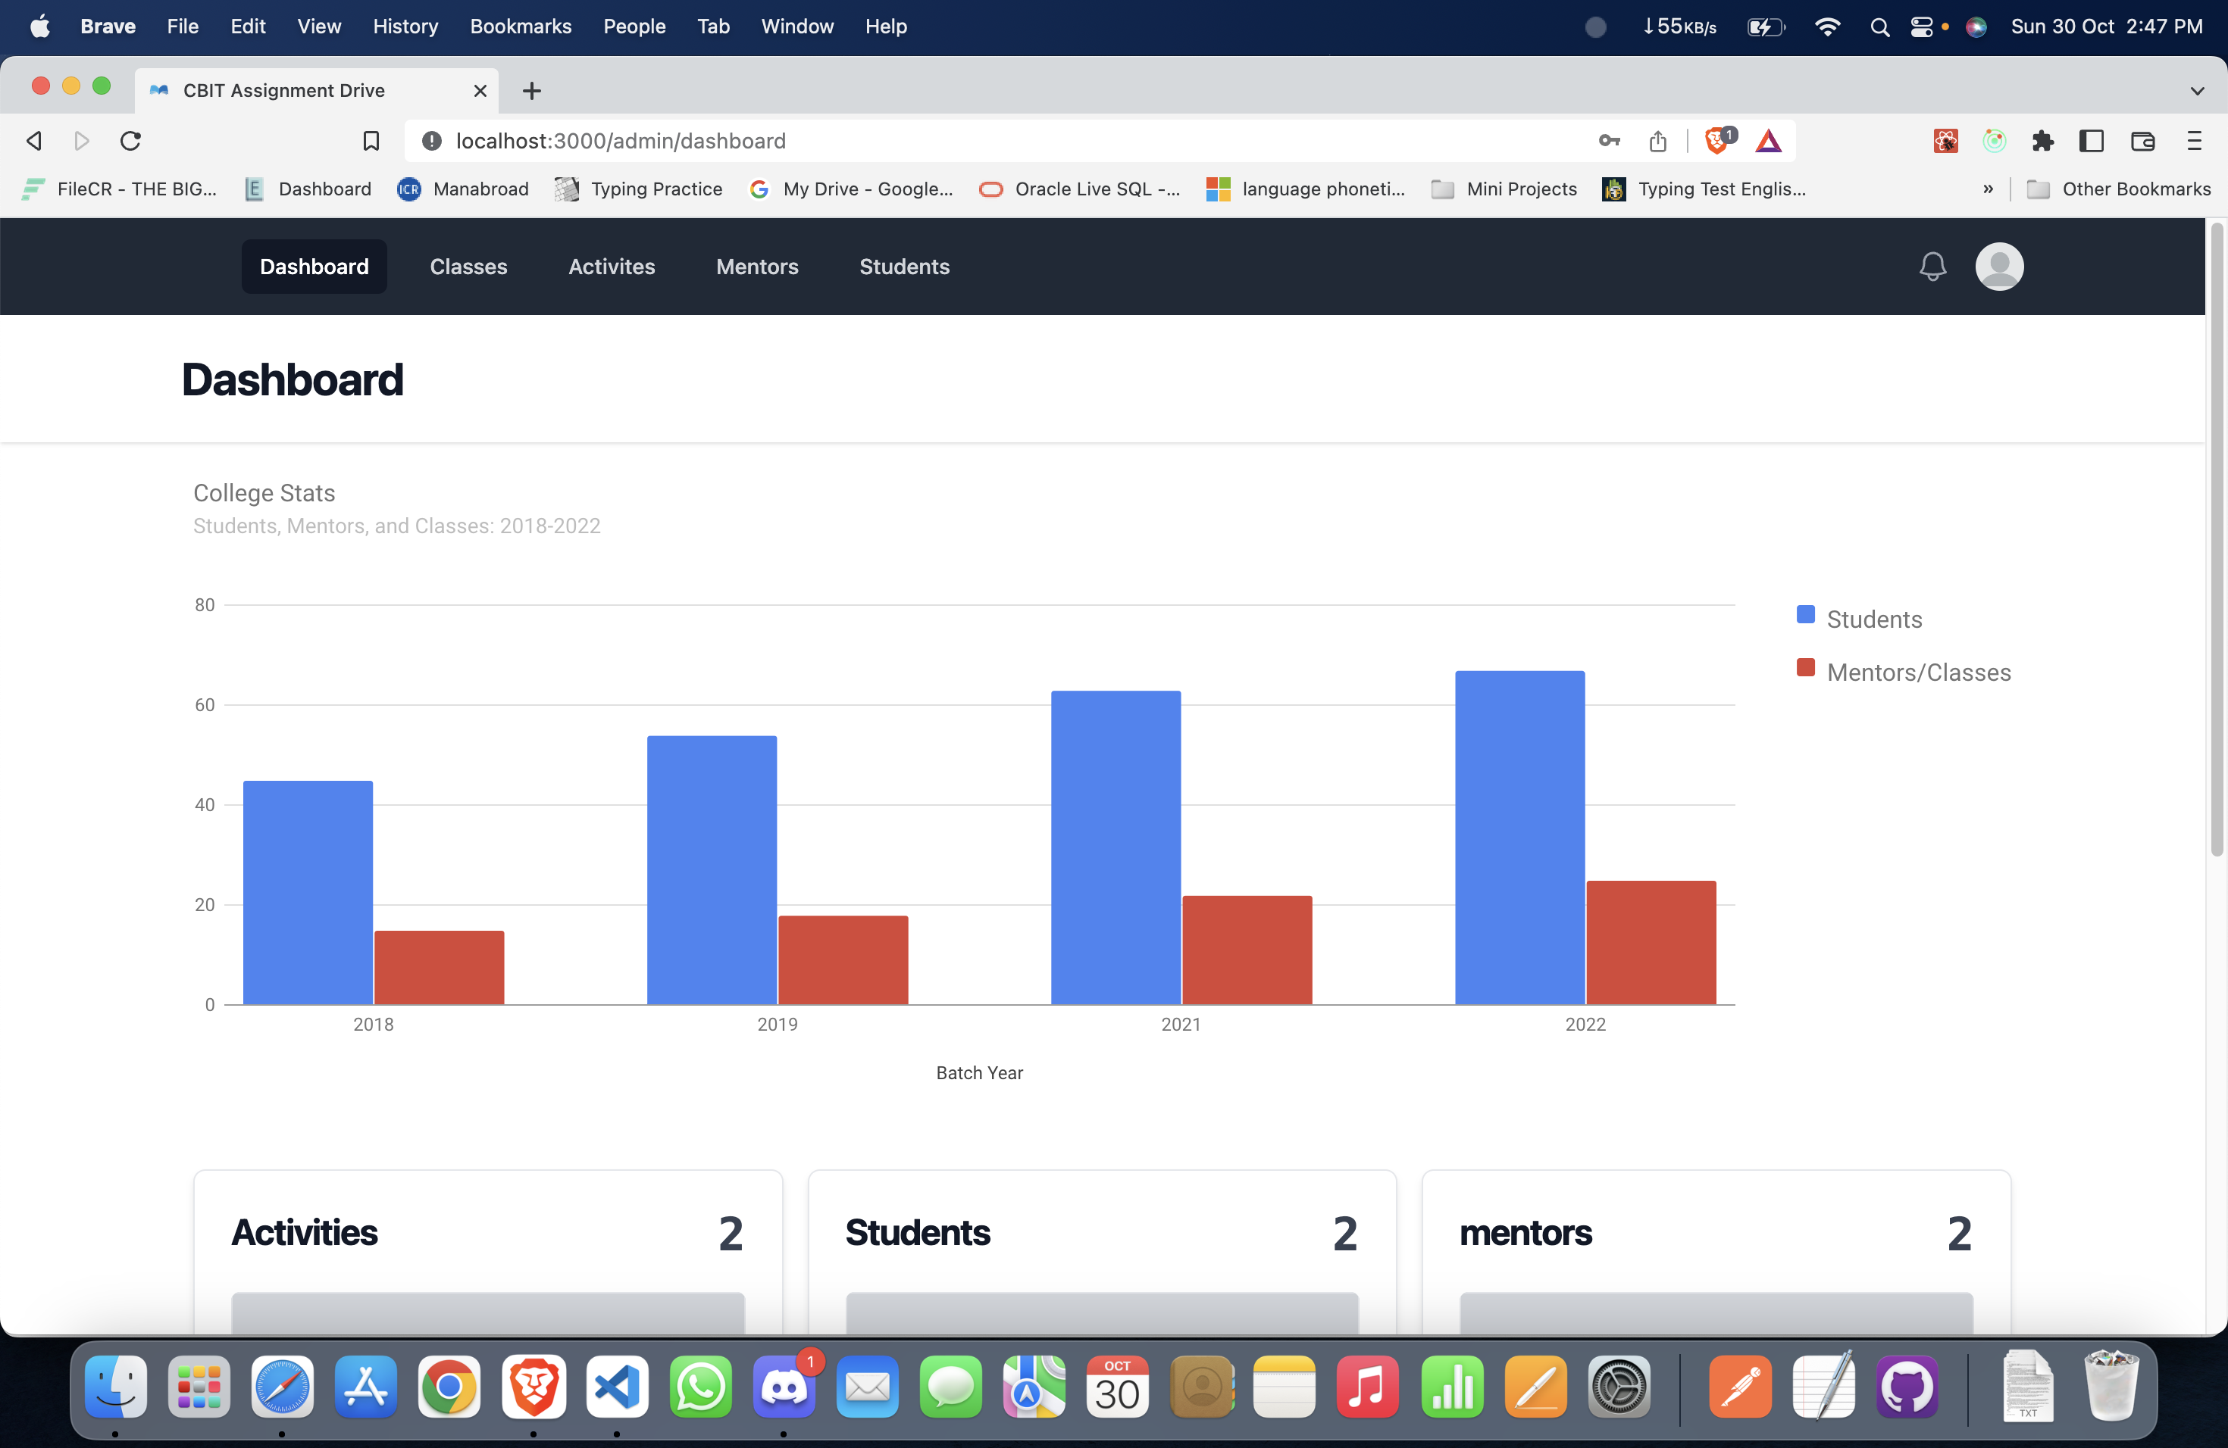

Slide 11
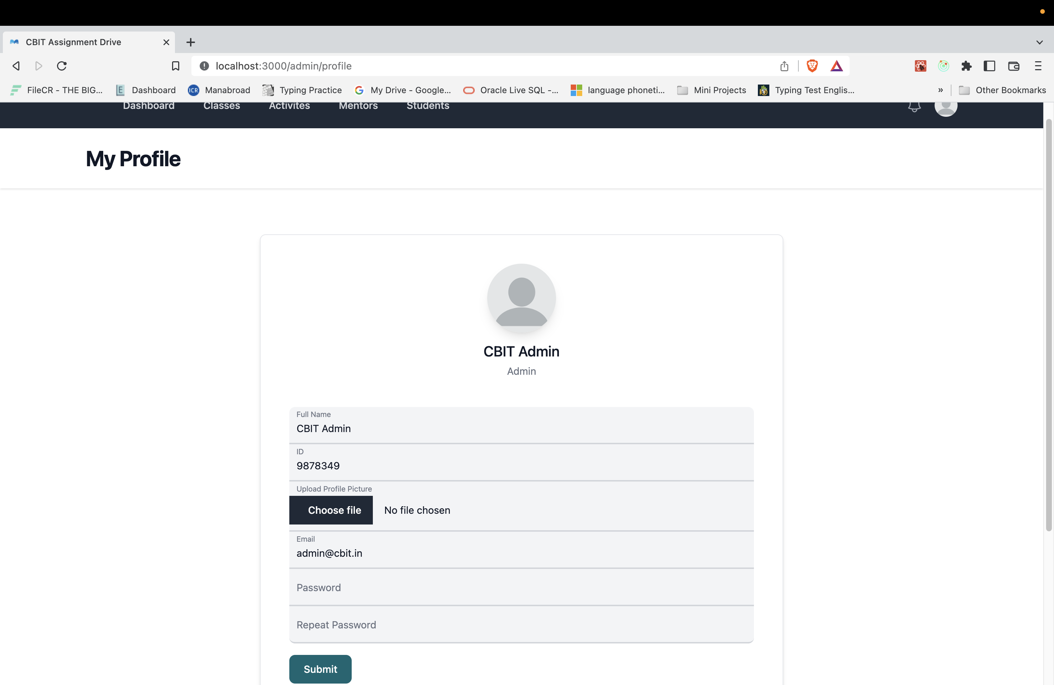

Slide 12
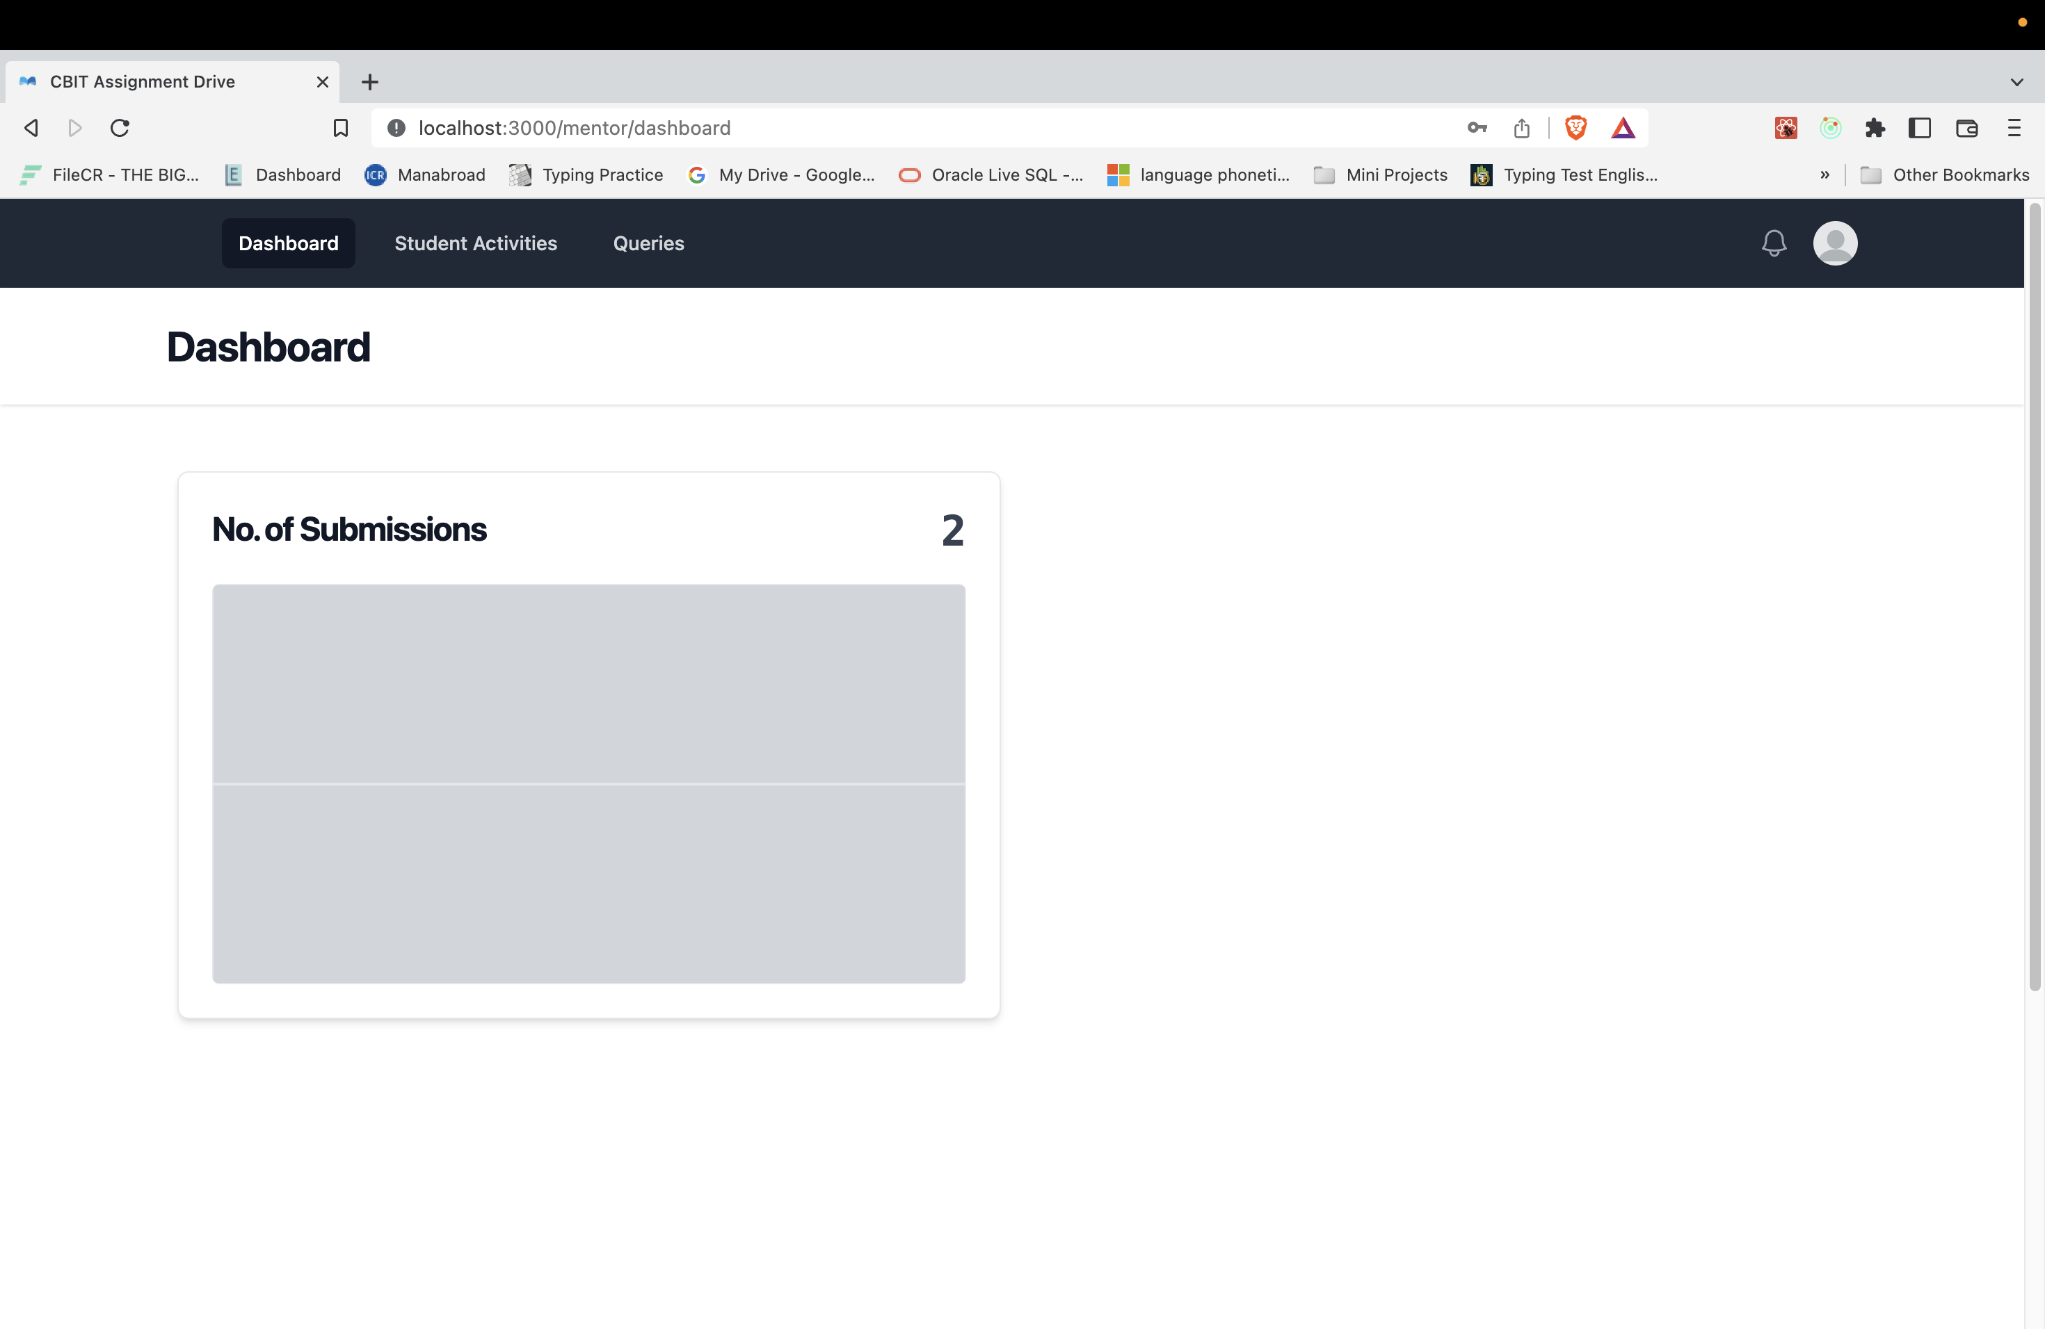

Slide 13
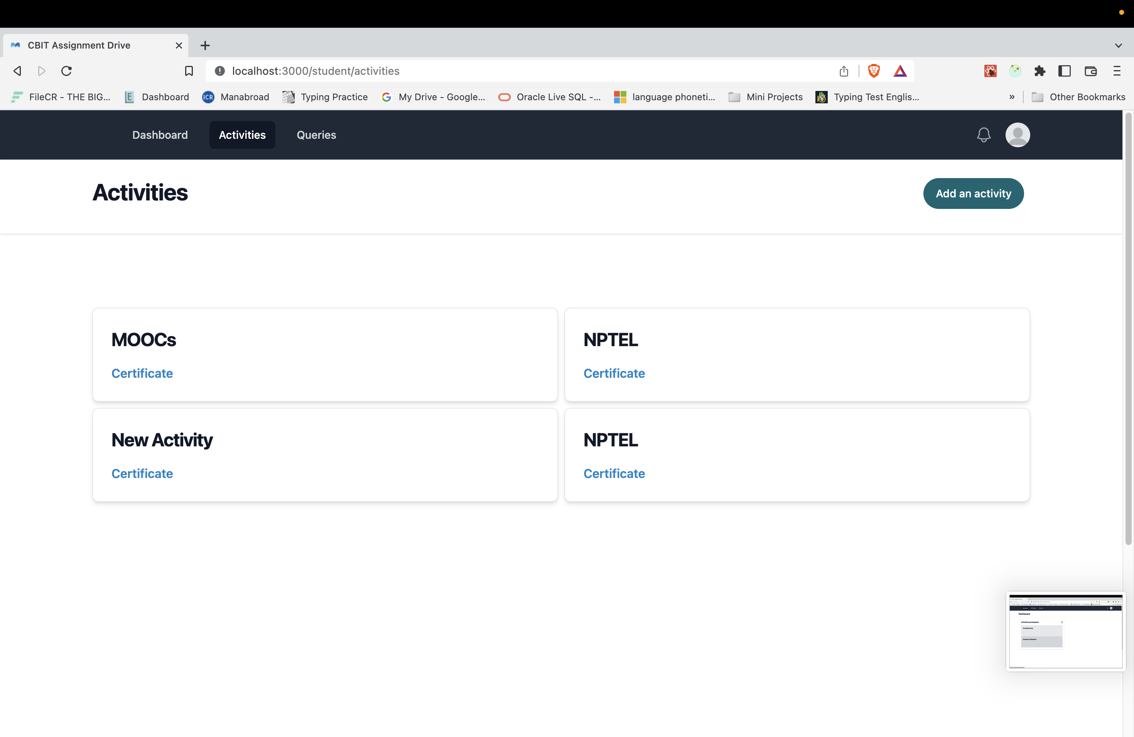

Slide 14
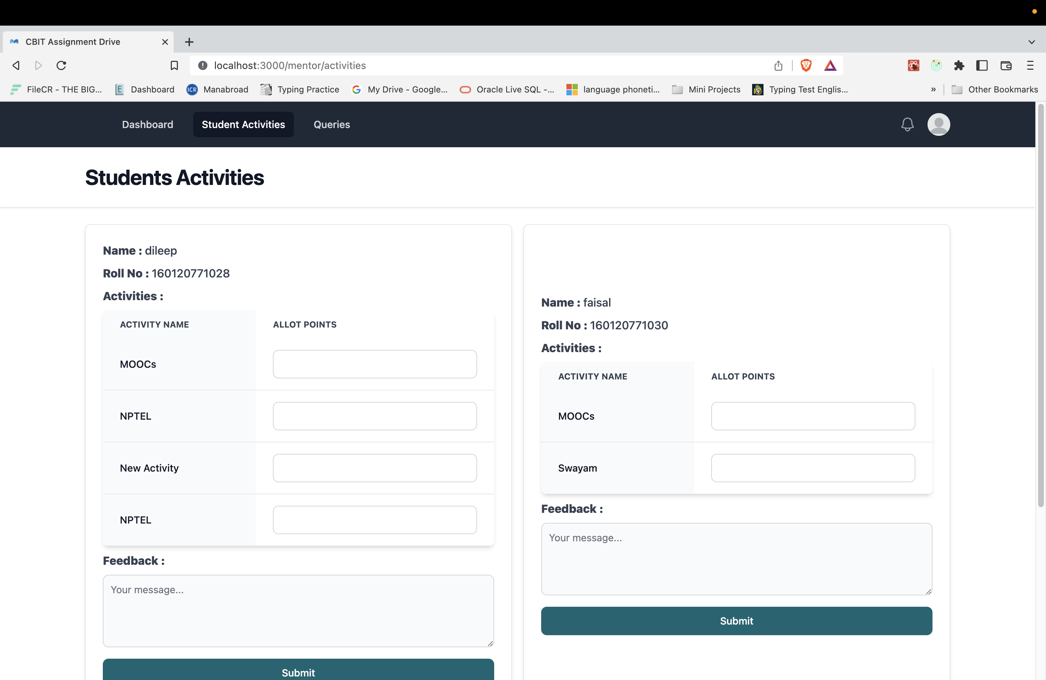

Slide 15
FUTURE SCOPE
A Query Section – For students to raise their doubts and mentors will clarify
Improve Dashboards
Email Notifications for upcoming events etc.
6
2022 HACKTOBERFEST. ALL RIGHTS RESERVED

Slide 16
THANK YOU
2022 HACKTOBERFEST. ALL RIGHTS RESERVED

